Slide 1
Machine Learning With Python
Nabajyoti Pathak

Slide 2
What is Neural Network??
Inventor of first neuron computer Dr Robert defines neural N/W as a computing system made up of number of simple, highly interconnected processing element, which process information by their dynamic state response to external inputs.
Neurons :- Human brains consist of 100 billons nerve cells call neurons
Axons :-Neurons are connected to other thousands cells by Axons.
Dendrites :- Input from sensory organs are accepted by dendrites.
This input create electric pulses which travels through neural network. A neurons then send it to other neurons or they drop it.
So we copy the structure of human brain and we call it as ANN (Artificial Neural Network)

Slide 3
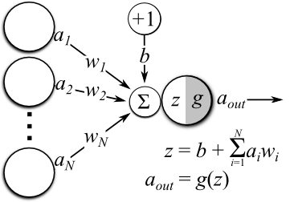
Perceptron
Single layer neural network.
Used for classification of patterns said to be linearly separable.
It consist of single neuron with adjustable synaptic weight and bias.

Slide 4
Simple intuition behind neural networks
If you have been a developer or seen one work – you know how it is to search for bugs in a code. You would fire various test cases by varying the inputs or circumstances and look for the output.
The change in output provides you a hint on where to look for the bug – which module to check, which lines to read. Once you find it, you make the changes and the exercise continues until you have the right code / application.

Slide 5
Simple intuition behind neural networks
Neural networks work in very similar manner. It takes several input, processes it through multiple neurons from multiple hidden layers and returns the result using an output layer. This result estimation process is technically known as “Forward Propagation“.
Next, we compare the result with actual output. The task is to make the output to neural network as close to actual (desired) output. Each of these neurons are contributing some error to final output. How do you reduce the error?
We try to minimize the value/ weight of neurons those are contributing more to the error and this happens while traveling back to the neurons of the neural network and finding where the error lies. This process is known as “Backward Propagation“.
In order to reduce these number of iterations to minimize the error, the neural networks use a common algorithm known as “Gradient Descent”, which helps to optimize the task quickly and efficiently.

Slide 6

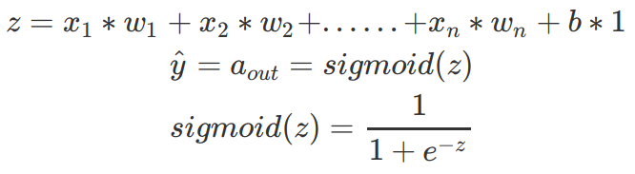
Terminologies of Neural Networks
Neuron(Node):- It is the basic unit of a neural network. It gets certain number of inputs and a bias value. When a signal(value) arrives, it gets multiplied by a weight value. If a neuron has 4 inputs, it has 4 weight values which can be adjusted during training time.
Connections :- It connects one neuron in one layer to another neuron in other layer or the same layer. A connection always has a weight value associated with it. Goal of the training is to update this weight value to decrease the loss(error).

Slide 7
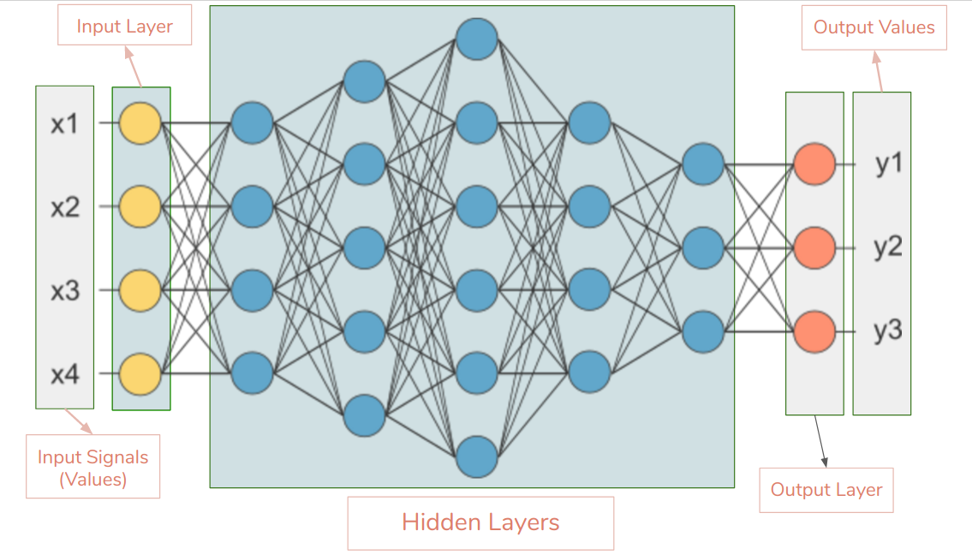

Slide 8
Input Layer — This is the first layer in the neural network. It takes input signals(values) and passes them on to the next layer. It doesn’t apply any operations on the input signals(values) & has no weights and biases values associated. In our network we have 4 input signals x1, x2, x3, x4.
Hidden Layers — Hidden layers have neurons(nodes) which apply different transformations to the input data. One hidden layer is a collection of neurons stacked vertically(Representation). In our image given below we have 5 hidden layers. In our network, first hidden layer has 4 neurons(nodes), 2nd has 5 neurons, 3rd has 6 neurons, 4th has 4 and 5th has 3 neurons. Last hidden layer passes on values to the output layer. All the neurons in a hidden layer are connected to each and every neuron in the next layer, hence we have a fully connected hidden layers.

Slide 9
Output Layer — This layer is the last layer in the network & receives input from the last hidden layer. With this layer we can get desired number of values and in a desired range. In this network we have 3 neurons in the output layer and it outputs y1, y2, y3.
Input Shape — It is the shape of the input matrix we pass to the input layer. Our network’s input layer has 4 neurons and it expects 4 values of 1 sample. Desired input shape for our network is (1, 4, 1) if we feed it one sample at a time. If we feed 100 samples input shape will be (100, 4, 1). Different libraries expect shapes in different formats.
Weights(Parameters) — A weight represent the strength of the connection between units. If the weight from node 1 to node 2 has greater magnitude, it means that neuron 1 has greater influence over neuron 2. A weight brings down the importance of the input value. Weights near zero means changing this input will not change the output. Negative weights mean increasing this input will decrease the output. A weight decides how much influence the input will have on the output.

Slide 10
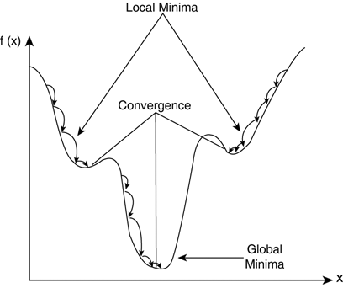
Learning Rate
Learning rate :-When we train neural networks we usually use Gradient Descent to optimize the weights. At each iteration we use back-propagation to calculate the derivative of the loss function with respect to each weight and subtract it from that weight. Learning rate determines how quickly or how slowly you want to update your weight(parameter) values. Learning rate should be high enough so that it won’t take ages to converge, and it should be low enough so that it finds the local minima.

Slide 11
Example
Imagine you work for a bank
You need to predict how many transactions each customer will make next year.

Slide 12
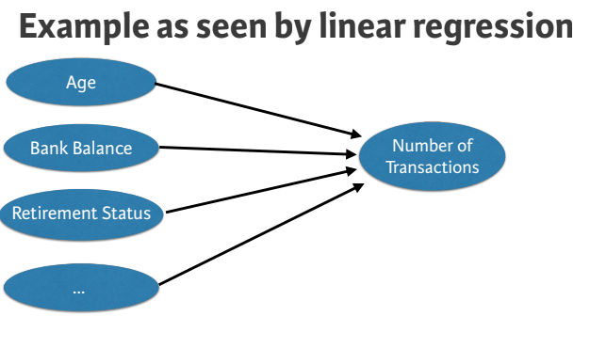

Slide 13
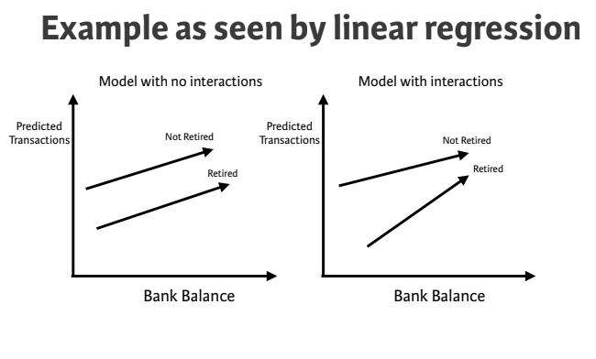

Slide 14
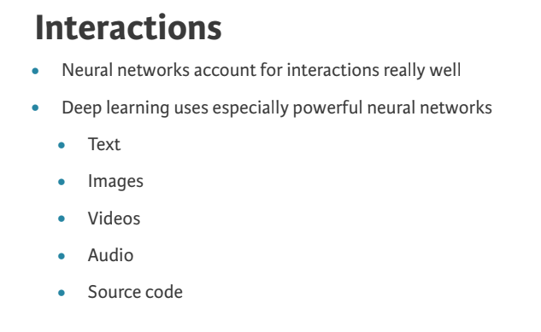

Slide 15
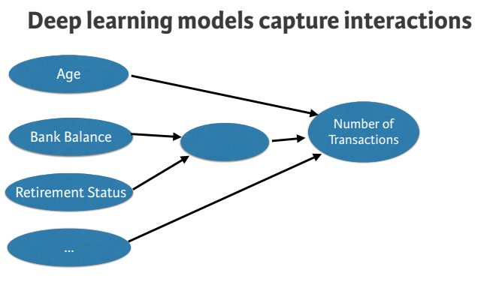

Slide 16
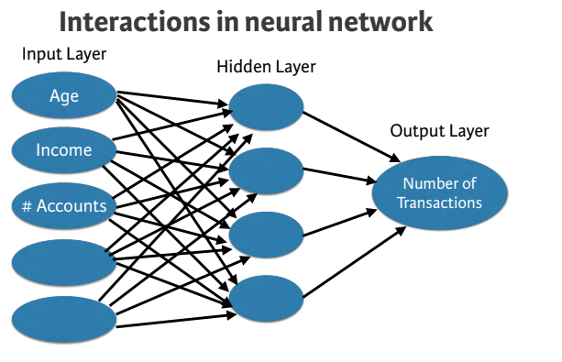

Slide 17
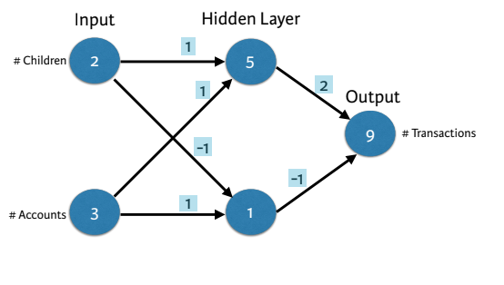
Forward Propagation
Bank transactions example:-
Make predictions based on:
Number of children
Number of existing accounts

Slide 18
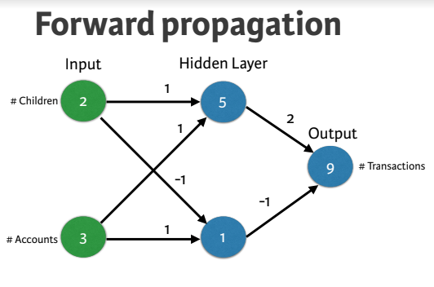

Slide 19
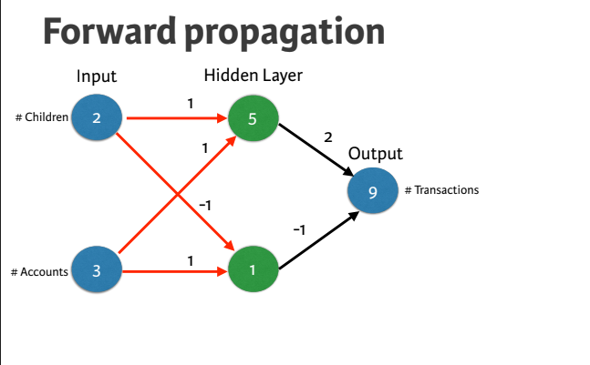

Slide 20
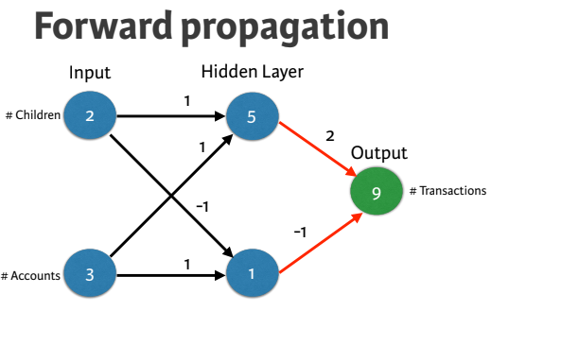

Slide 21
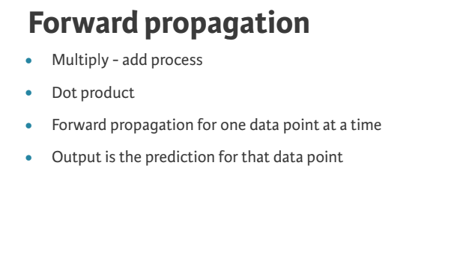

Slide 22
Activation functions
Activation functions are really important for a Artificial Neural Network to learn and make sense of something really complicated and Non-linear complex functional mappings between the inputs and response variable.

Slide 23
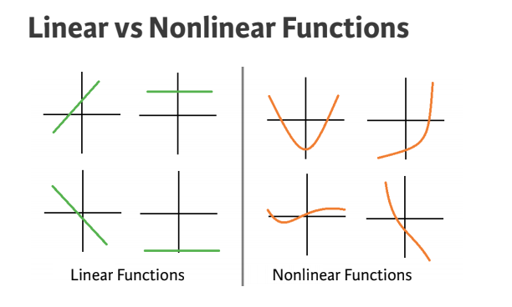

Slide 24
Activation functions
For neural network to achieve maximum prediction power we must apply something call activation function in Hidden layer.
Applied to node inputs to produce node output
It allows the model to capture non-linearity

Slide 25
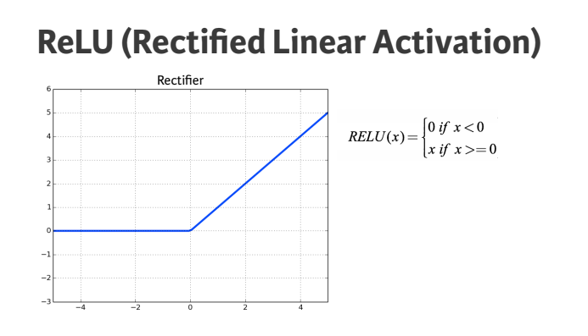

Slide 26
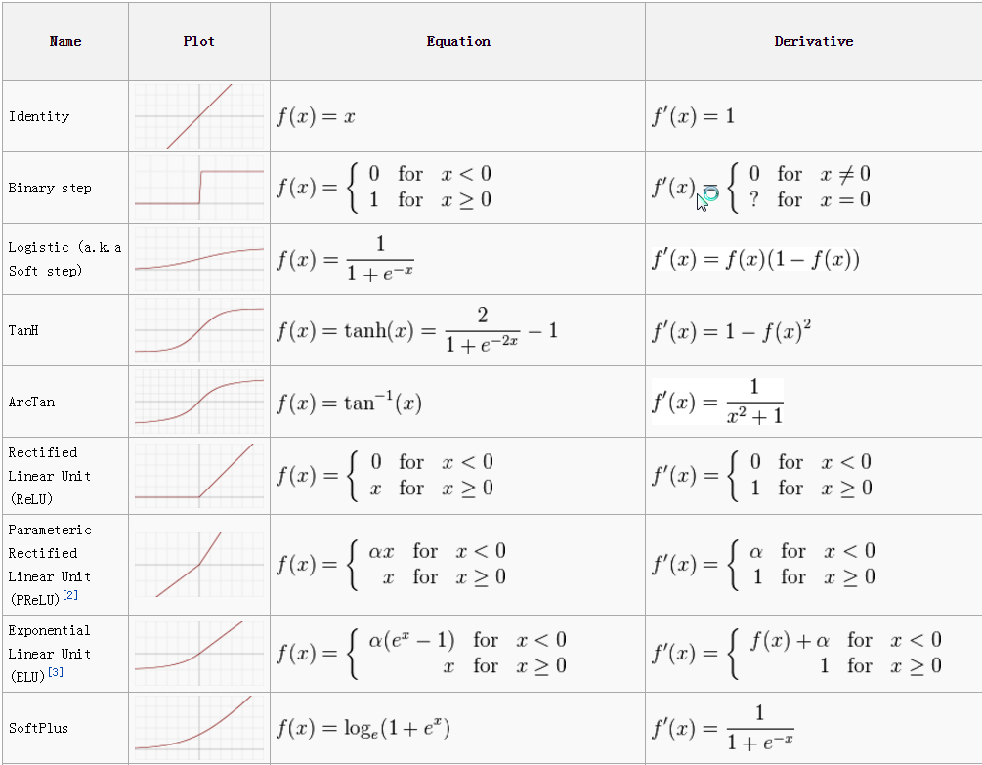

Slide 27
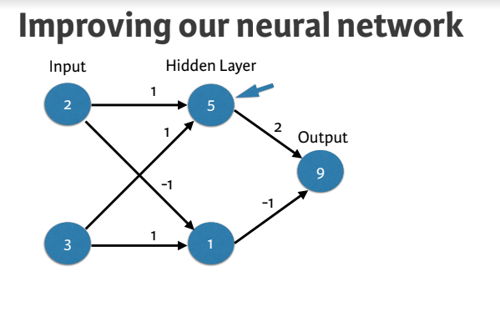

Slide 28
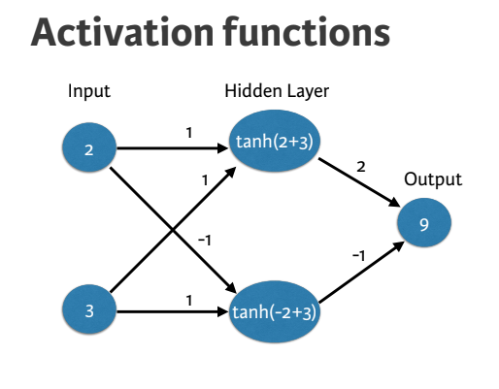

Slide 29
Deeper networks

Slide 30
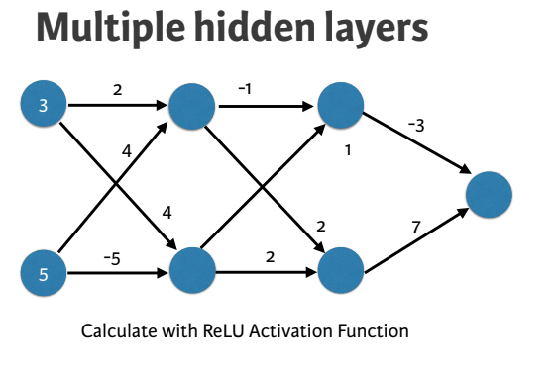

Slide 31
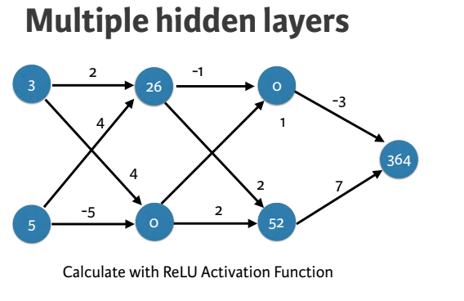

Slide 32
Representation learning
Deep networks internally build representations of patterns in the data
Partially replace the need for feature engineering
Subsequent layers build increasingly sophisticated representations of raw data

Slide 33
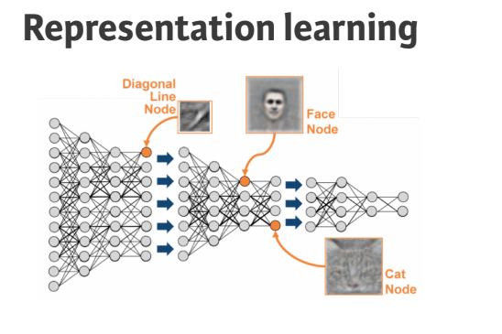

Slide 34
Deep learning
Modeler doesn’t need to specify the interactions
When you train the model, the neural network gets weights that find the relevant patterns to make better predictions

Slide 35
The need for optimization

Slide 36
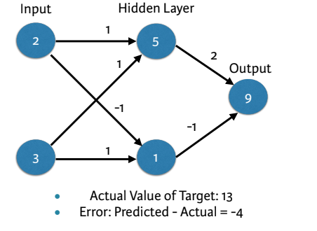
A baseline neural network

Slide 37
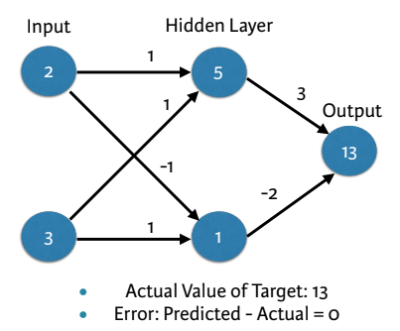
A baseline neural network

Slide 38
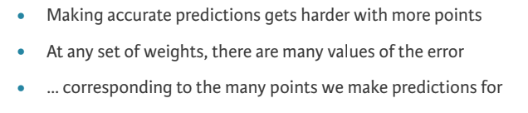
Predictions with multiple points

Slide 39
Loss function
Aggregates errors in predictions from many data points into single number
Measure of model’s predictive performance

Slide 40
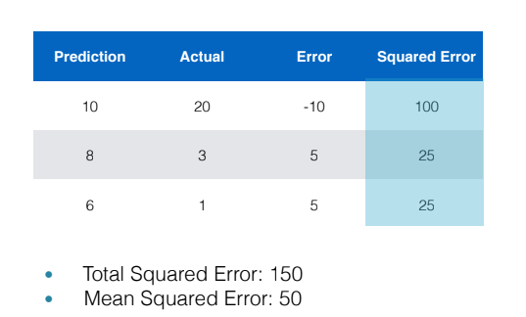
Squared error loss function

Slide 41
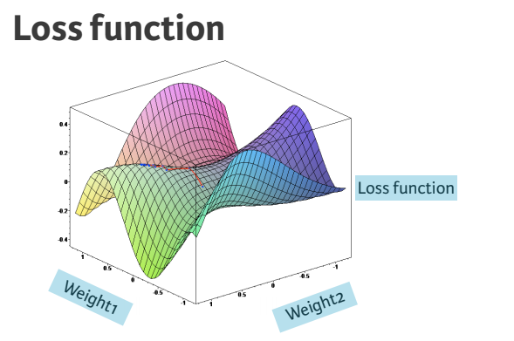

Slide 42
Loss function
Lower loss function value means a better model
Goal: Find the weights that give the lowest value for the loss function
Gradient descent

Slide 43
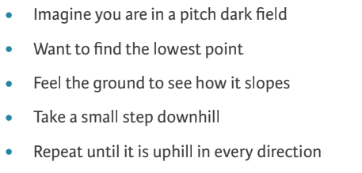
Gradient descent

Slide 44
Gradient descent steps
Start at random point
Until you are somewhere flat:
Find the slope
Take a step downhill

Slide 45
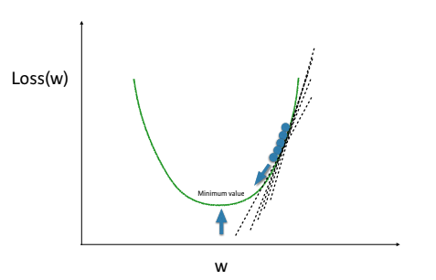
Optimizing a model with a single weight

Slide 46
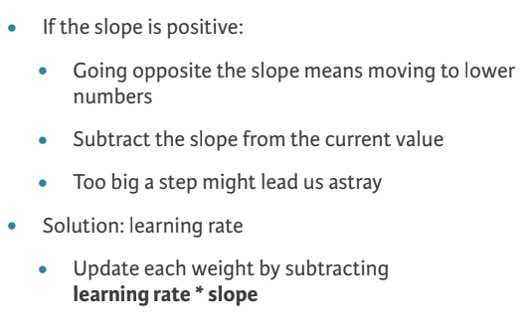
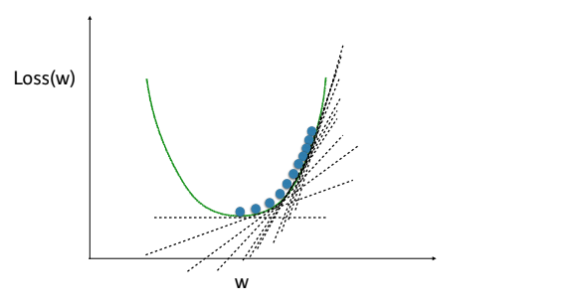
Gradient descent

Slide 47
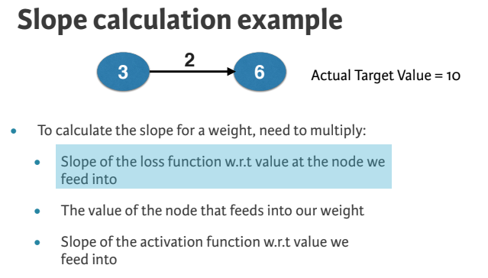

Slide 48
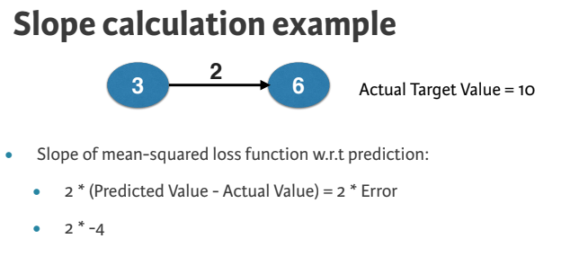

Slide 49
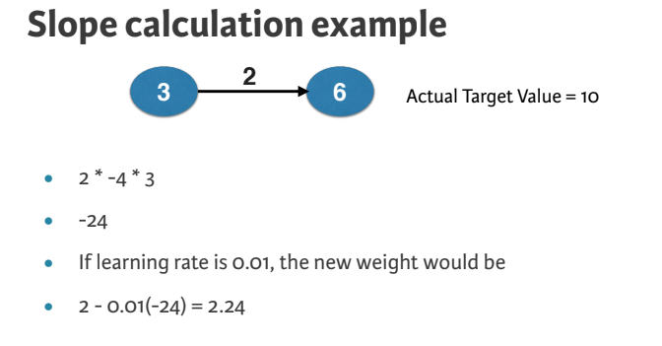

Slide 50
Backpropagation

Slide 51
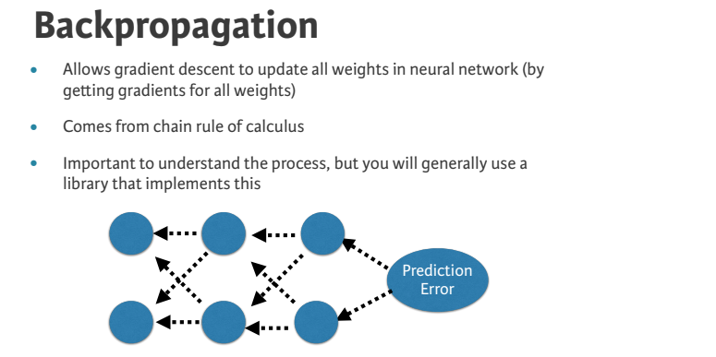

Slide 52
Backpropagation process
Trying to estimate the slope of the loss function w.r.t each weight
Do forward propagation to calculate predictions and errors

Slide 53
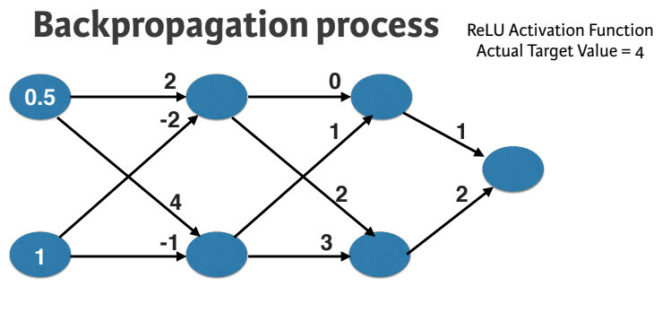

Slide 54
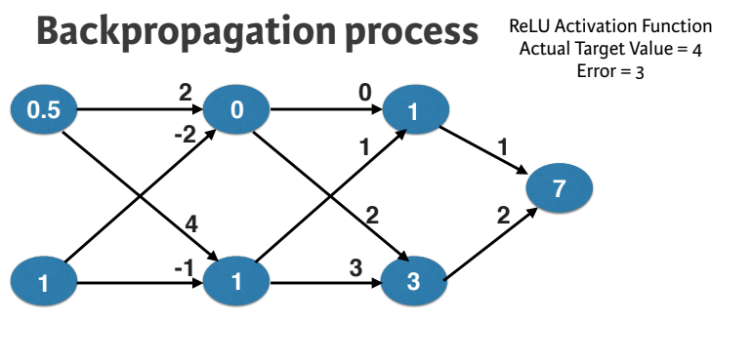

Slide 55
Backpropagation process
Go back one layer at a time
Gradients for weight is product of:
1. Node value feeding into that weight
2. Slope of loss function w.r.t node it feeds into
3. Slope of activation function at the node it feeds into

Slide 56
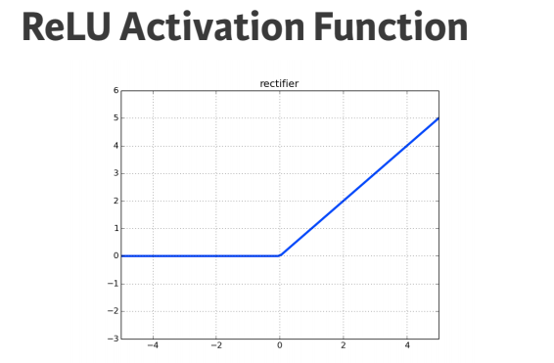

Slide 57
Backpropagation process
Need to also keep track of the slopes of the loss function w.r.t node values
Slope of node values are the sum of the slopes for all weights that come out of them

Slide 58
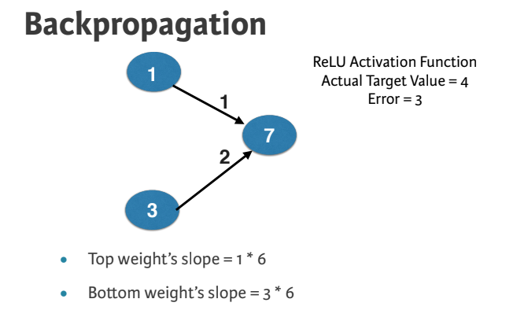

Slide 59
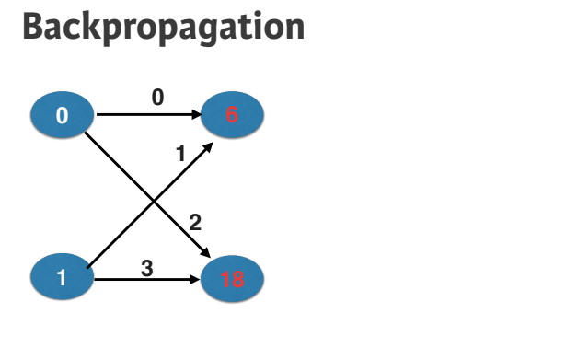

Slide 60
Calculating slopes associated with any weight
Gradients for weight is product of:
Node value feeding into that weight
Slope of activation function for the node being fed into
Slope of loss function w.r.t output node

Slide 61
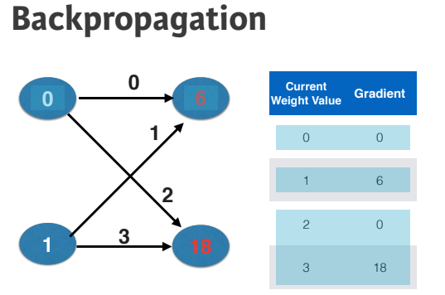

Slide 62
Stochastic gradient descent
It is common to calculate slopes on only a subset of the data (‘batch’)
Use a different batch of data to calculate the next update
Start over from the beginning once all data is used
Each time through the training data is called an epoch
When slopes are calculated on one batch at a time:
stochastic gradient descent

Slide 63
Tutorial on Keras

Slide 64
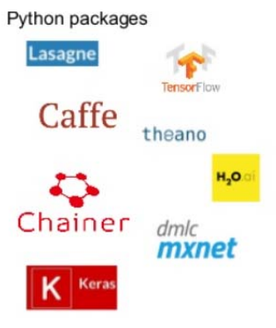
Deep learning packages
TensorFlow – Google
PyTorch – Facebook AI research
Keras – Francois Chollet (now at Google)
Chainer – Company in Japan
Caffe - Berkeley Vision and Learning Center
CNTK - Microsoft

Slide 65
What is Keras ?
Deep neural network library in Python
High-level neural networks API
Modular – Building model is just stacking layers and connecting computational graphs
Runs on top of either TensorFlow or Theano or CNTK
Why use Keras ?
Useful for fast prototyping, ignoring the details of implementing backprop or writing optimization procedure
Supports Convolution, Recurrent layer and combination of both.
Runs seamlessly on CPU and GPU
Almost any architecture can be designed using this framework
Open Source code – Large community support

Slide 66
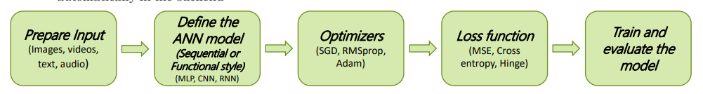
Implementing a neural network in Keras
Five major steps
Preparing the input and specify the input dimension (size)
Define the model architecture and build the computational graph
Specify the optimizer and configure the learning process
Specify the Inputs, Outputs of the computational graph (model) and the Loss function
Train and test the model on the dataset
Note: Gradient calculations are taken care by Auto – Differentiation and parameter updates are done automatically in the backend

Slide 67
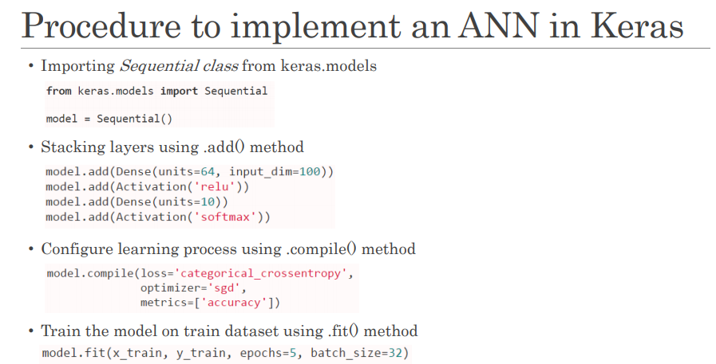

Slide 68
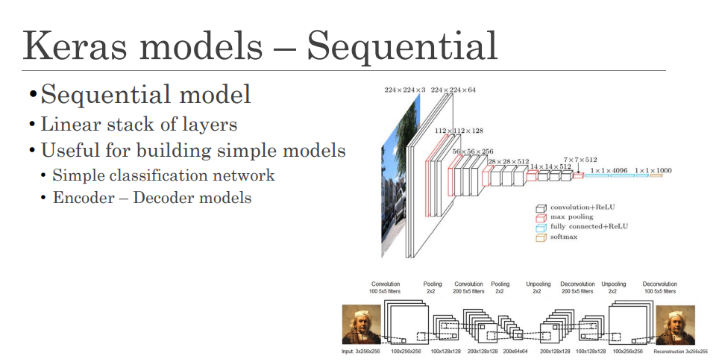

Slide 69
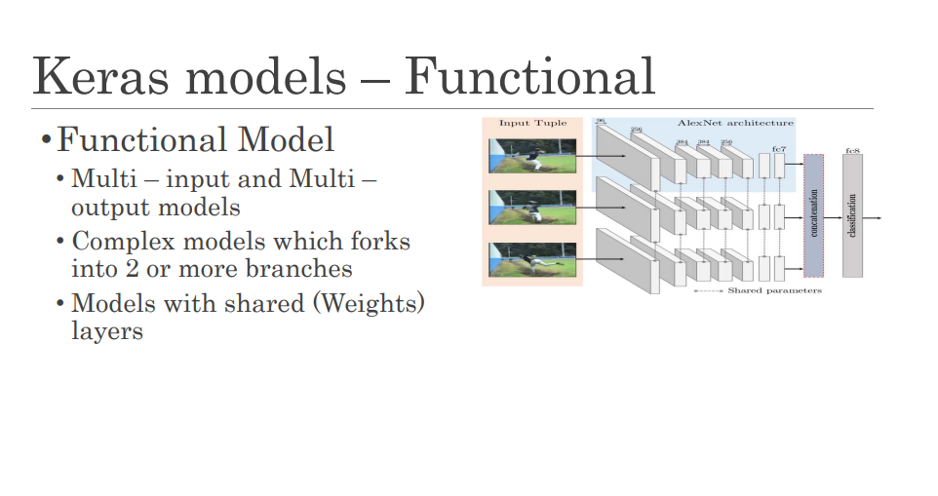

Slide 70
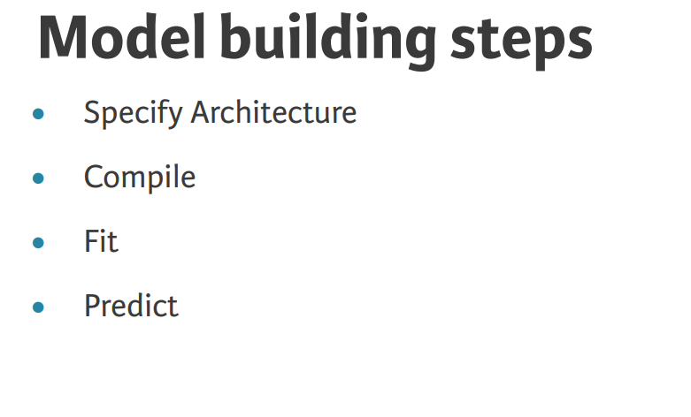

Slide 71
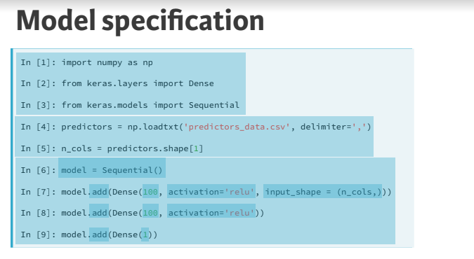

Slide 72
Compiling and fitting a model
Specify the optimizer
Many options and mathematically complex
“Adam” is usually a good choice
Loss function
“mean_squared_error” common for regression

Slide 73
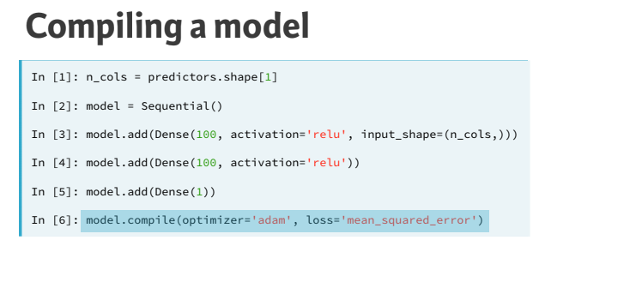

Slide 74
What is fitting a model???
Applying back-propagation and gradient descent with your data to update the weights
Scaling data before fitting can ease optimization

Slide 75
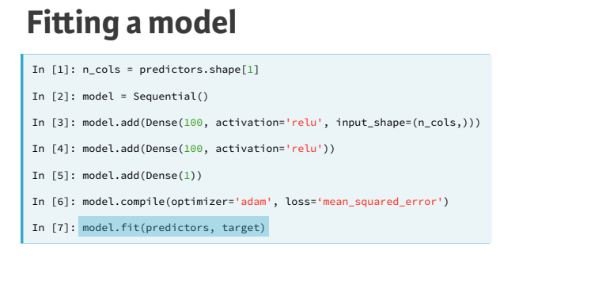

Slide 76
Classification models

Slide 77
Classification
‘categorical_crossentropy’ loss function
Similar to log loss: Lower is better
Add metrics = [‘accuracy’] to compile step for easy-tounderstand diagnostics
Output layer has separate node for each possible outcome, and uses ‘so"max’ activation

Slide 78


Slide 79


Slide 80


Slide 81


Slide 82


Slide 83


Slide 84


Slide 85
Model validation

Slide 86
Validation in deep learning
Commonly use validation split rather than cross validation
Deep learning widely used on large datasets
Single validation score is based on large amount of data, and is reliable
Repeated training from cross-validation would take long time

Slide 87


Slide 88


Slide 89


Slide 90
Thinking about model capacity

Slide 91


Slide 92
Workflow for optimizing model capacity
Start with a small network
Gradually increase capacity
Keep increasing capacity until validation score is no longer improving

Slide 93


Slide 94


